Slide 1




Northeast Energy Direct Project
NEW HAMPSHIRE

Slide 2
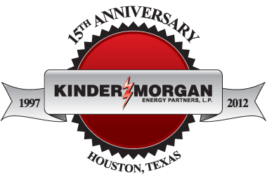
About Kinder Morgan
Kinder Morgan is one of the largest, most experienced energy companies in North America. We own an interest in or operate approximately 80,000 miles of pipelines and 180 terminals.
Kinder Morgan employs approximately 11,500 people throughout the United States and Canada.
We are committed to operating our assets in a safe, ethical and transparent manner.
We ensure public safety and safe pipeline operations through employee training, regular testing, right-of-way aerial and foot patrols and adherence to our comprehensive Integrity Management plan and procedures.
Kinder Morgan does not have a Political Action Committee (PAC), or make any political contributions.

Slide 3
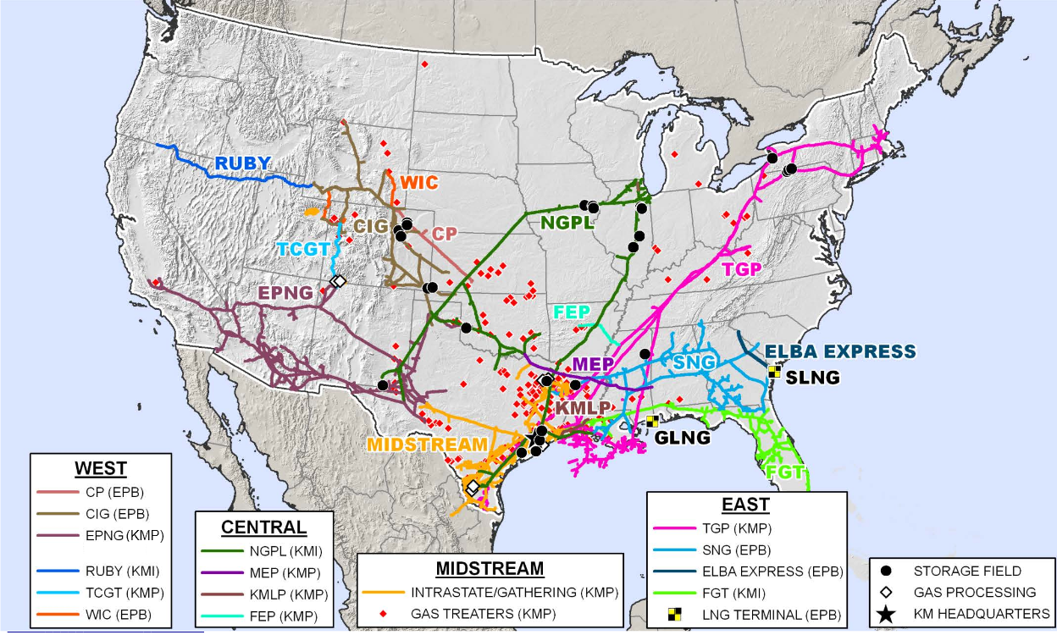
Kinder Morgan Natural Gas Pipelines

Slide 4
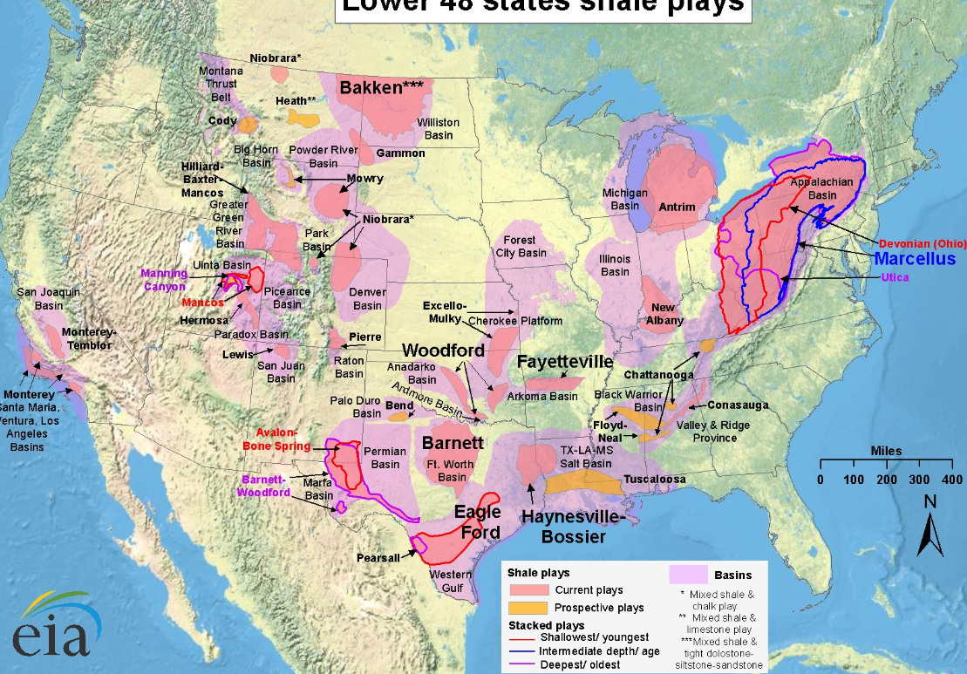
U.S. Shale Plays

Slide 5
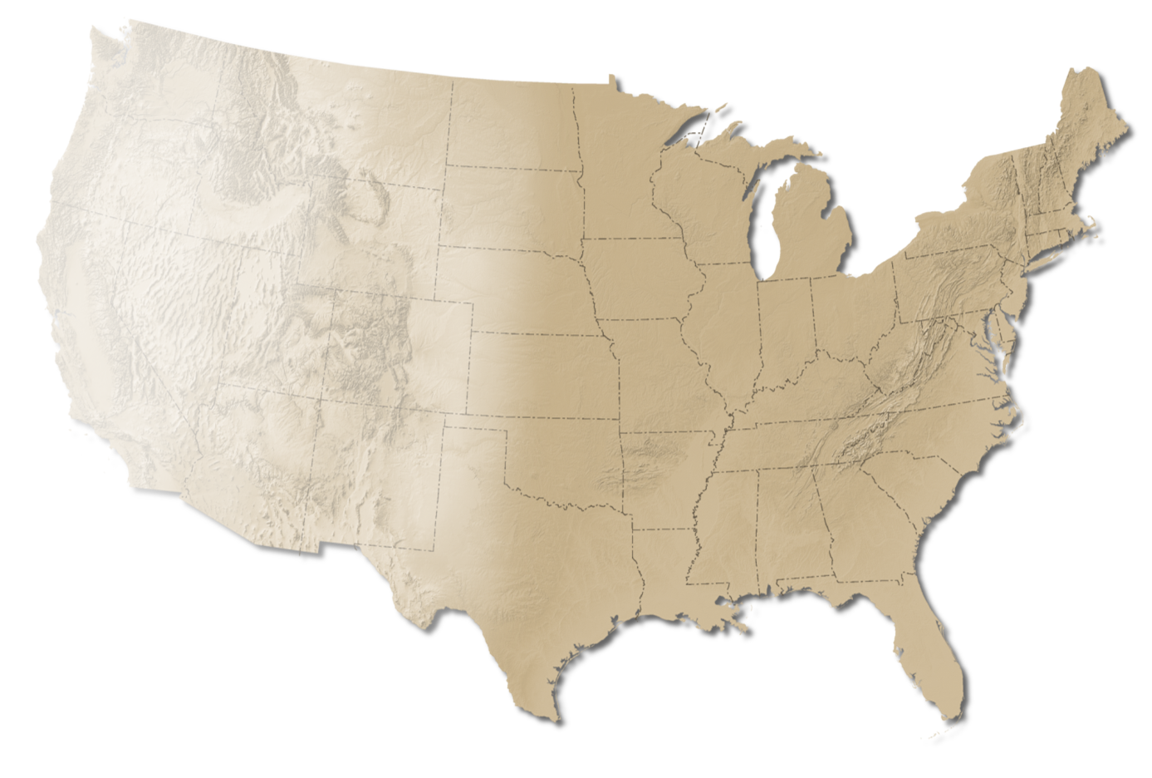

Tennessee Gas Pipeline
System Overview
  13,900 miles of pipeline
  79 Bcf of storage capacity
  ~8.0 Bcf/d – design capacity
  1.4 million horsepower
  >500 FT customers
  35 MM households equivalent
  Delivered ~390 Bcf to New England customers in 2012
  Abundant & Growing Supply
    Marcellus, Utica, Eagle Ford, Haynesville, Fayetteville
Northeast
Utica Shale
Marcellus Shale
Southeast
Haynesville Shale
EagleFord Shale

Slide 6
TGP’s Existing Shippers in New England
New England LDC Customers
EnergyNorth Natural Gas (NH)
Northern Utilities (ME)
Fitchburg Gas & Electric Light Co. (MA)
Colonial Gas Co. (MA)
Essex County Gas Co. (MA)
Boston Gas Co. (MA)
NSTAR Gas Co. (MA)
Bay State Gas Co. aka Columbia Gas of MA (MA)
Blackstone Gas Co. (MA, Municipal)
Narragansett Electric Co. d/b/a National Grid (RI)
Holyoke Gas & Electric (MA, Municipal)
Westfield Gas & Electric Dept. (MA, Municipal)
Berkshire Gas Co. (MA)
Connecticut Natural Gas Co. (CT)
Southern Connecticut Gas Co. (CT)
Yankee Gas Services Co. (CT)
New England Power Generators
Granite Ridge LLC
Entergy RISE
Blackstone GDFSUEZ

Slide 7
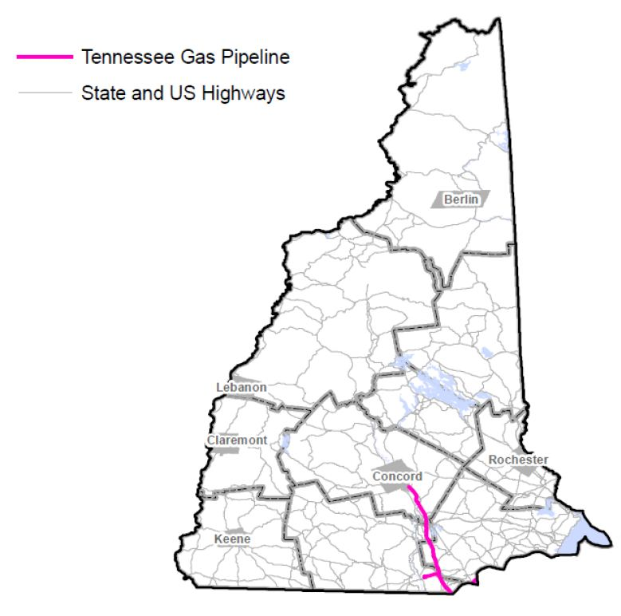
NH Municipalities with Existing TGP Lines
TGP has existing pipelines in 10 municipalities and three counties in New Hampshire.
Hillsborough County:
Hudson
Manchester
Pelham
Merrimack County:
Allenstown
Concord
Hooksett
Pembroke
Rockingham County:
Londonderry
Salem
Windham

Slide 8
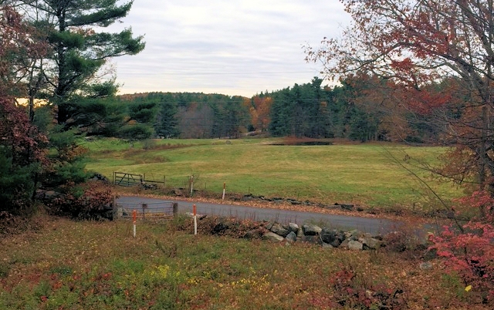
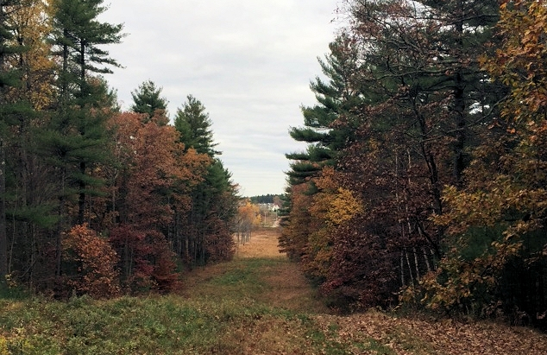
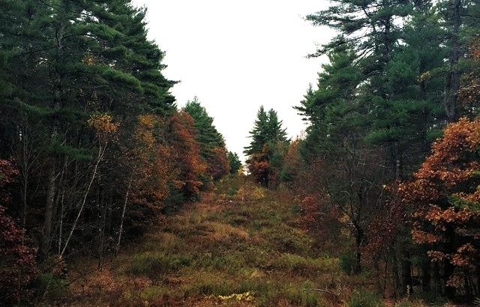
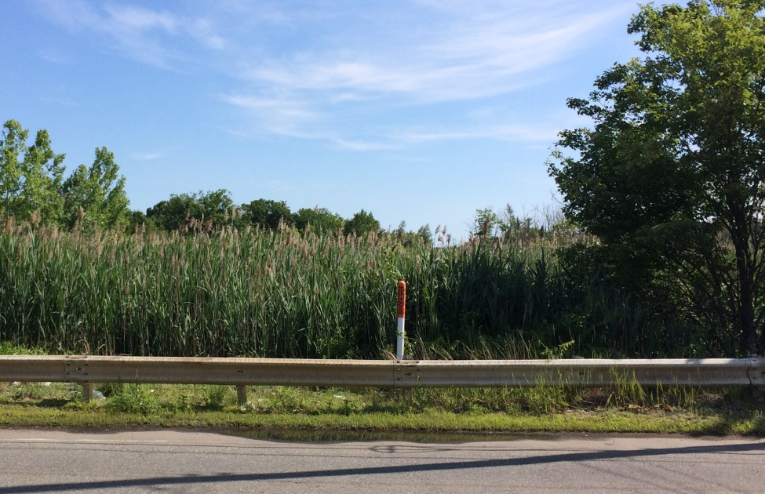
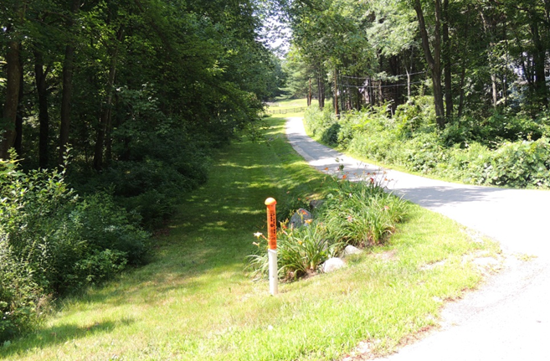
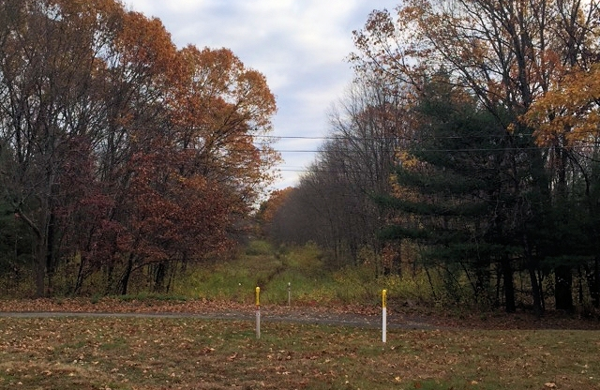
Existing Rights-of-Way in New Hampshire
Pelham, NH
Pelham, NH
Windham, NH
Salem, NH

Slide 9
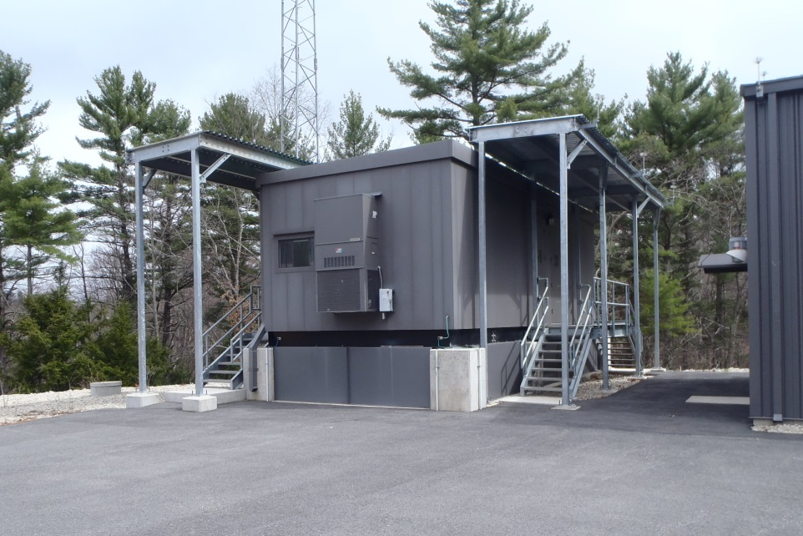
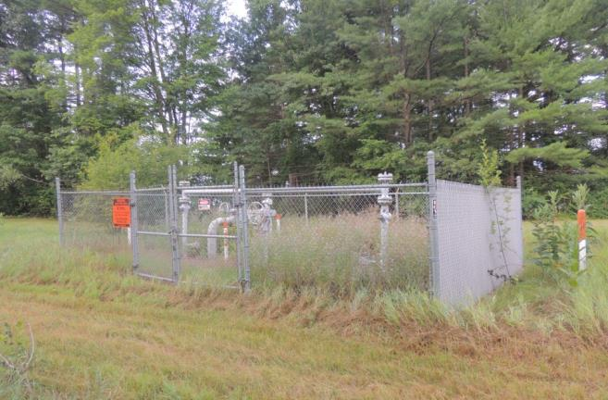
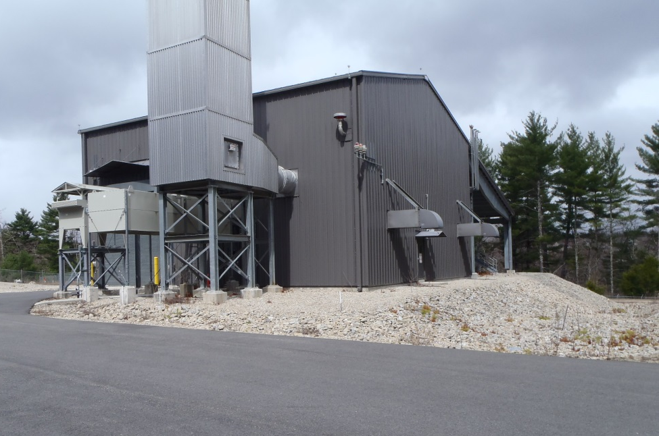
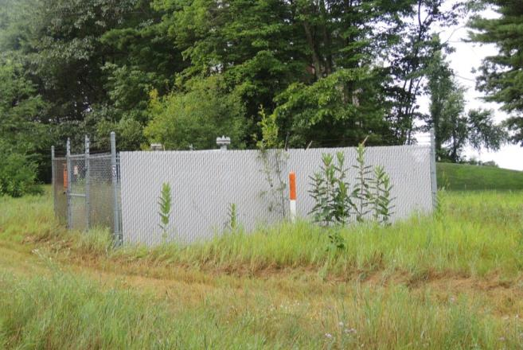
Existing Valve & Compressor Stations in New England
Compressor Station in Pelham, NH
Valve Station in Bolton, MA
Compressor Station in Pelham, NH
Valve Station in Bolton, MA

Slide 10
NEW HAMPSHIRE

Slide 11
KINDER MORGAN NEW HAMPSHIRE ASSETS
In New Hampshire,
Kinder Morgan operates approximately 50 miles of pipeline
In 2013, Kinder Morgan paid approximately $1.2 million to state and local taxing bodies.
Kinder Morgan owns or operates assets in Hillsborough, Rockingham and Merrimack Counties

Slide 12
The Need for the Northeast Energy Direct Project

Slide 13
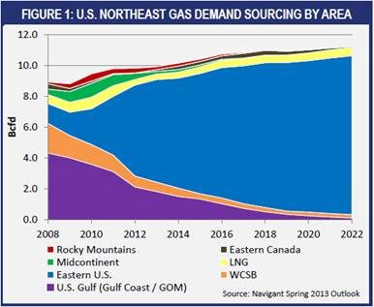
Current Sources of New England Natural Gas
New England’s Gas Needs:
In 2013, New England relied on natural gas for 52% of its electricity produced, more than any other source. (Source: ISO-NE)
Tennessee Gas Pipeline and Algonquin Gas Pipeline are the two major pipelines transporting natural gas to New England. (Source: U.S. Energy Information Administration)
Sources of New England’s Gas Supply:
  In 2012, the Northeast region received 60% of its gas supply from Eastern US sources, mainly shale formations. (Source: Navigant North American Natural Gas Market Outlook, Spring 2013)
  In 2008, the Northeast received only 14% of its natural gas from Appalachia/Eastern U.S. sources such as the Marcellus shale. (Source: Navigant, Spring 2013)
  It is estimated that by 2022, based on current trends and source supply that the Northeast will receive 92% of ifs gas supply from Eastern US sources. (Source: Navigant North American Natural Gas Market Outlook, Spring 2013)

Slide 14
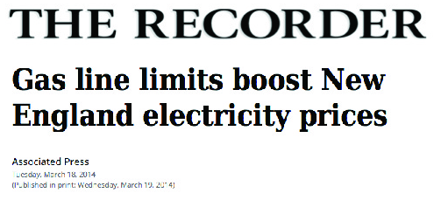
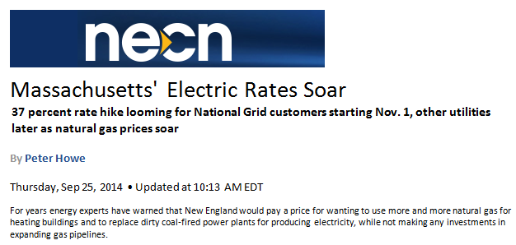
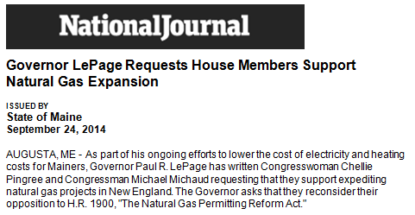
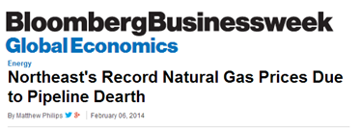
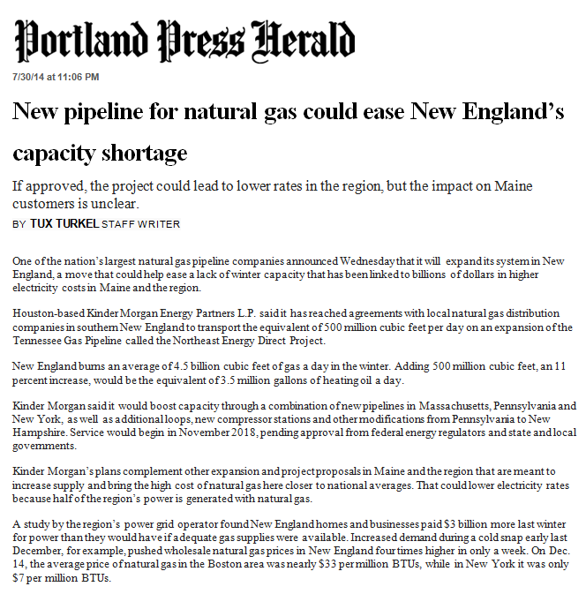
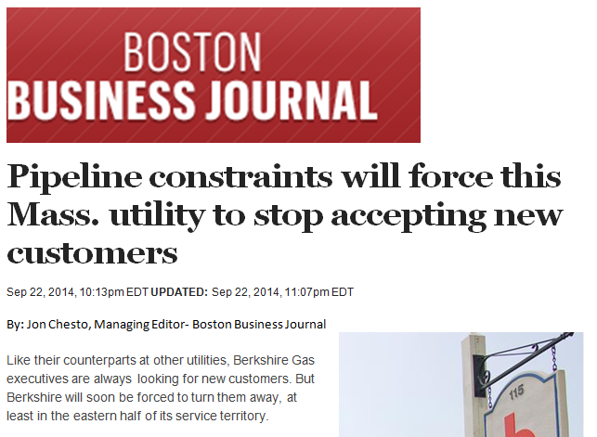
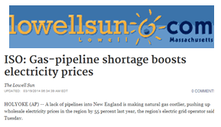
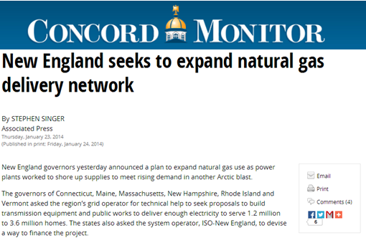
Northeast Energy Crisis
Unprecedented gas capacity constraints on existing pipelines
(Source: ISO-NE, EIA.gov)
Highest and most volatile gas commodity costs in the nation
(Source: ISO-NE, EIA.gov)

Slide 15
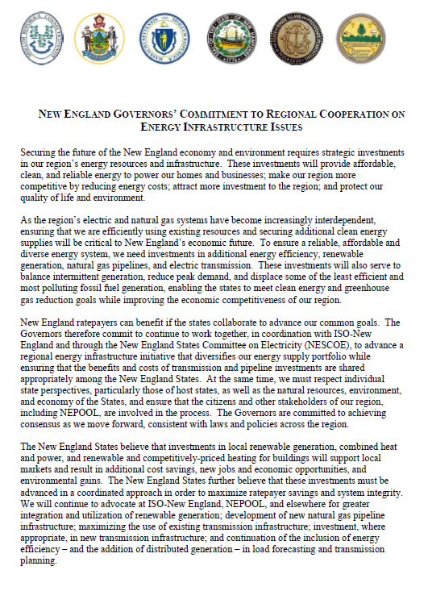
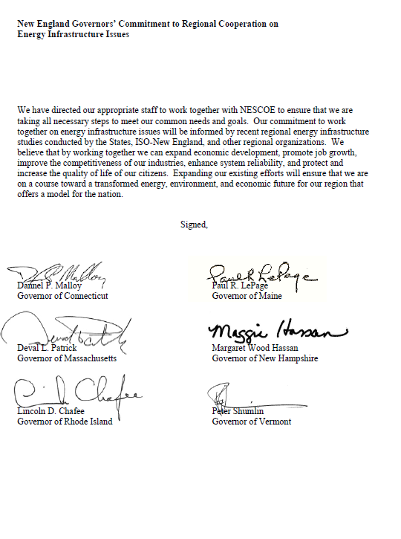
Governors’ Statement on Northeast Energy Infrastructure
In Dec. 2013, New England Governors called attention to the shortage of energy infrastructure.
An open letter was signed by Governors Malloy (CT), LePage (ME), Patrick (MA), Hassan (NH), Chafee (RI), and Shumlin (VT).
“To ensure a reliable, affordable and diverse energy system, we need investments in additional energy efficiency, renewable generation, natural gas pipelines, and electric transmission.”
“These investments will provide affordable, clean, and reliable energy to power our homes and businesses; make our region more competitive by reducing energy costs; attract more investment to the region; and protect our quality of life and environment.”

Slide 16
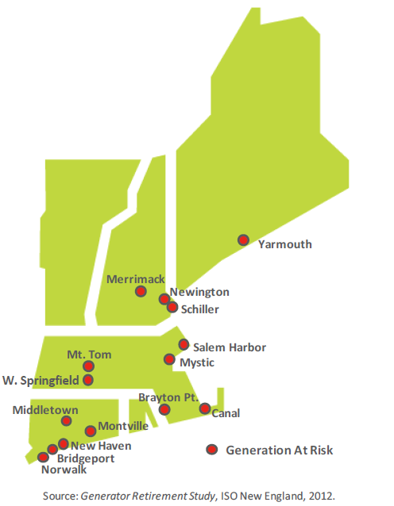
Northeast Energy Crisis
The energy situation is likely to worsen if no new capacity is constructed;
Currently, four large New England coal, oil and nuclear power plants are planning to retire in the next few years due to increasing operating costs and new emissions standards. This includes the Brayton Point and Salem Harbor Plants in MA, the Norwalk Harbor Plant in CT, and the Vermont Yankee plant in VT. (Source: ISO-NE, 2013)
Unless new capacity is provided, New England’s power system will be increasingly vulnerable to electric service disruptions and consumer prices will increase greatly. The region will be at a large economic and competitive disadvantage to neighboring states and regions due to high energy costs. (Source: New England States Committee on Electricity, 2014)
Solution:
NESCOE, ISO-NE, and New England’s Governors have all publically identified natural gas pipelines as a solution to the Northeast Energy crisis.

Slide 17
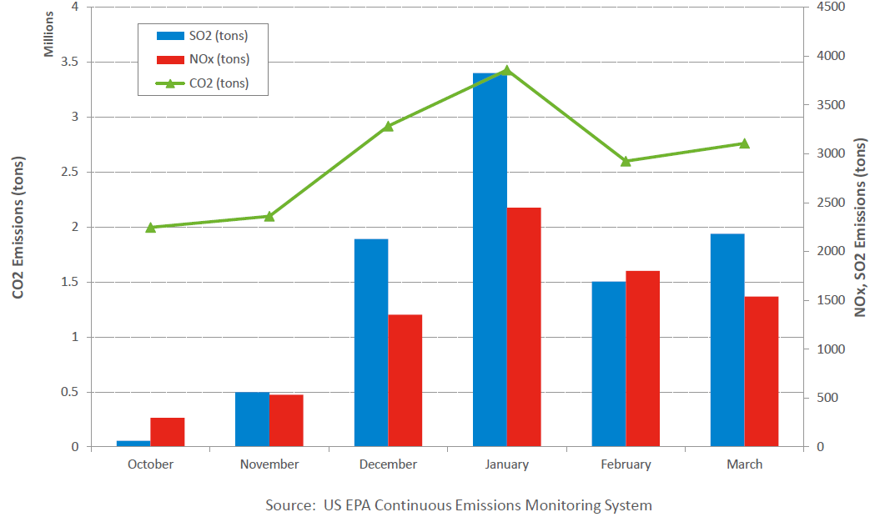
Northeast Energy Crisis
Natural gas shortages during recent winters have been costly and have increased pollution in New England.
New Englanders paid an additional $3 Billion in electricity costs in the winter of 2013/2014 due to natural gas capacity shortages. (ISO-NE, 2014)
Natural gas pipeline constraints last winter forced utilities to burn coal and oil in order to continue generating electricity, resulting in increased sulfur dioxide (SO₂), nitrogen oxide (NO_{X}) and carbon dioxide (CO₂) emissions. (Source: ISO-NE, “Transformation of the Electric Power Industry…”, 2014)
New England’s CO₂, SO₂, and NO_{x} emissions skyrocketed last winter due to a shortage of natural gas for electricity generation.

Slide 18
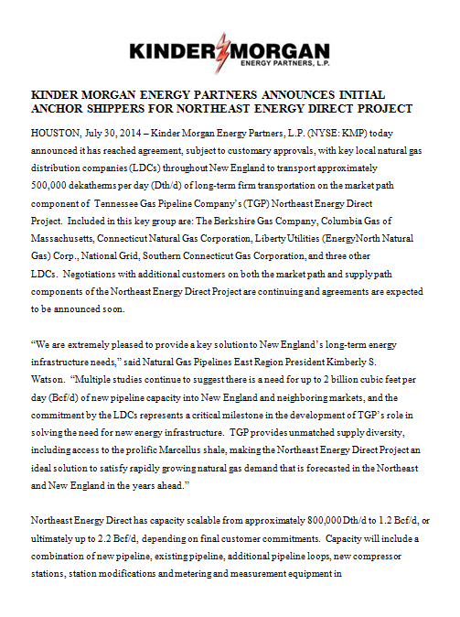
KM Announces Initial Anchor Shippers
On July 30, 2014, Kinder Morgan announced it had reached agreement with key local natural gas distribution companies (“LDCs”) throughout New England to transport approximately 500,000 Dth/d of long-term firm transportation on the Northeast Energy Direct Project route.
These LDC’s include;
The Berkshire Gas Company
Columbia Gas of Massachusetts
Connecticut Natural Gas Corporation
Liberty Utilities (EnergyNorth Natural Gas) Corp.
National Grid
Southern Connecticut Gas Corporation

Slide 19
Northeast Energy Direct Project Introduction

Slide 20
Northeast Energy Direct Project Overview
The Northeast Energy Direct Project will expand the existing Tennessee Gas Pipeline system within Pennsylvania, New York, Massachusetts, New Hampshire and Connecticut.
The expansion will help meet increased demand in the U.S. Northeast for transportation capacity for natural gas.
Following completion, the proposed project could bring an estimated increased capacity of up to 2.2 Bcf/d to the Northeast, which is equivalent to an additional 1.5MM households.
The pre-filing process allows for open and transparent interaction between FERC Staff and stakeholders regarding the Project before the formal certificate application is filed, and is intended for early identification and resolution of environmental and other important issues. During pre-filing, TGP will file detailed draft environmental resource reports with FERC for review and comment.
FERC Docket #: PF14-22-000
Estimated Project Schedule
Action | Timing
Outreach Meetings | Ongoing
Route Selection and Permit Preparation | Ongoing
Agency Consultations | Ongoing
File for FERC Pre-Filing | Nov. 5, 2014
FERC Filing | 4th Quarter 2015
Anticipated FERC Approval | 4th Quarter 2016
Proposed Start of Construction Activity | January 2017
Proposed In-Service | November 2018

Slide 21




Regulatory Oversight
Federal, state and local agencies will have extensive regulatory authority over the proposed project. Some of these include:
Federal
Federal Energy Regulatory Commission
U.S. Army Corps of Engineers - New England District
U.S. Environmental Protection Agency
U.S. Fish and Wildlife Service
U.S. Department of Agriculture
U.S. Department of the Interior - National Park Service
U.S. Bureau of Land Management
State
New Hampshire Department of Environmental Services
New Hampshire Fish and Game Department
New Hampshire Division of Historical Resources
New Hampshire Division of Forests and Lands
New Hampshire Site Evaluation Committee
Local
New Hampshire Town Conservations Commissions

Slide 22
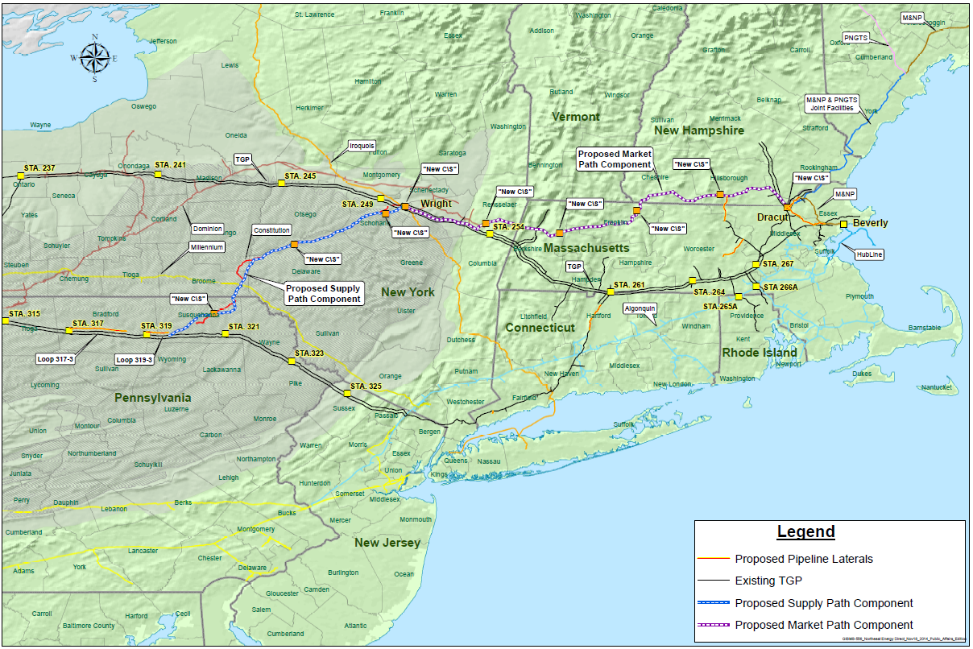
Proposed Northeast Energy Direct Route

Slide 23
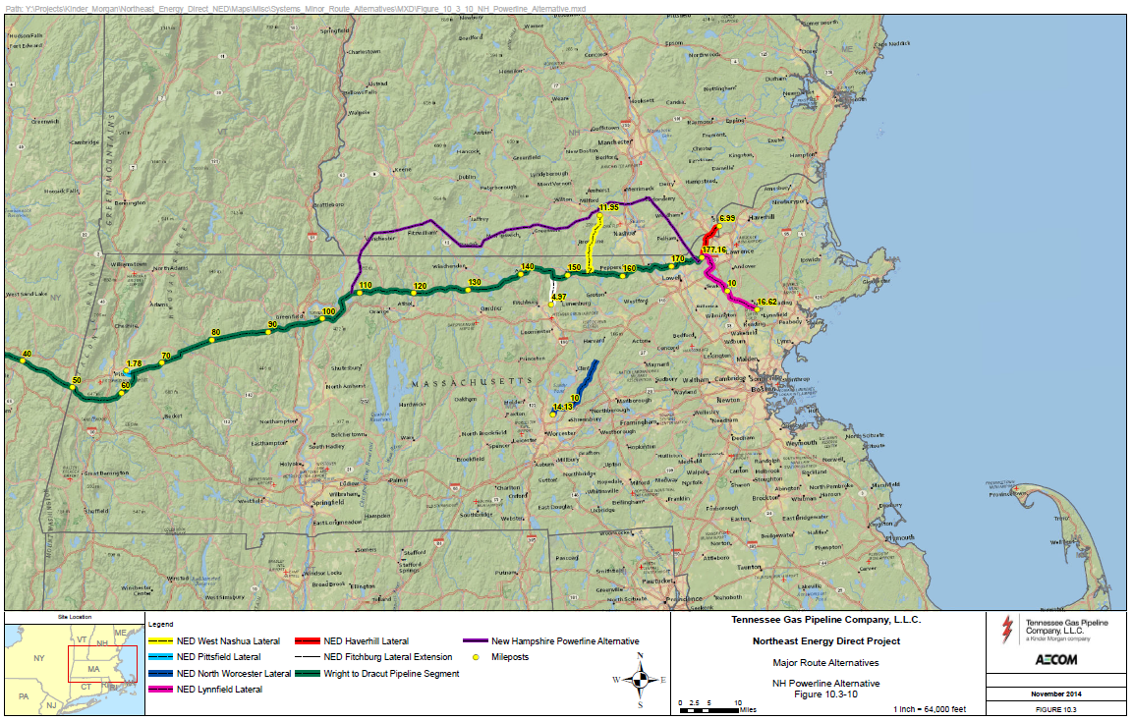
NED NH Powerline Alternative

Slide 24
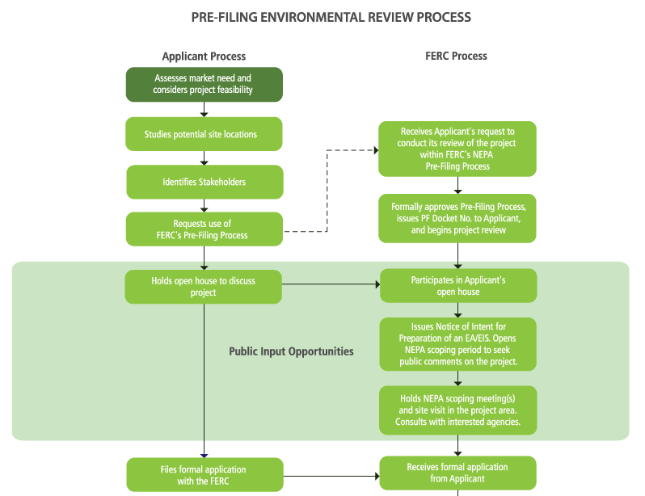
The FERC Review Process (part 1)

Slide 25
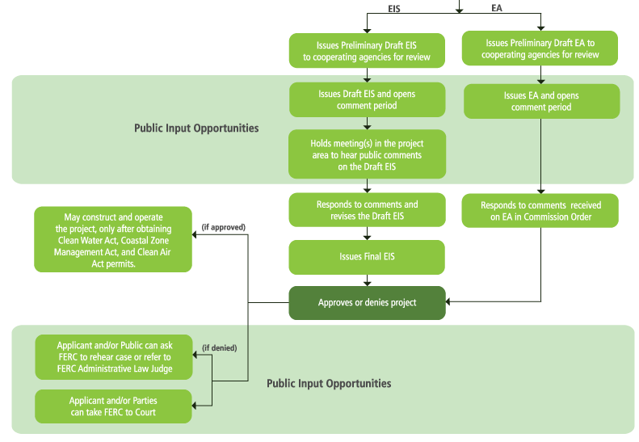
The FERC Review Process (part 2)

Slide 26
Preliminary NED Powerline Alternative Town List (NH)
Cheshire County
Fitzwilliam, NH
Richmond, NH
Rindge, NH
Troy, NH
Winchester, NH
Rockingham County
Londonderry, NH
Salem, NH
Windham, NH
Hillsborough County
Amherst, NH
Brookline, NH
Greenville, NH
Hudson, NH
Litchfield, NH
Mason, NH
Merrimack, NH
Milford, NH
New Ipswich, NH
Pelham, NH

Slide 27
Northeast Energy Direct Project Benefits

Slide 28
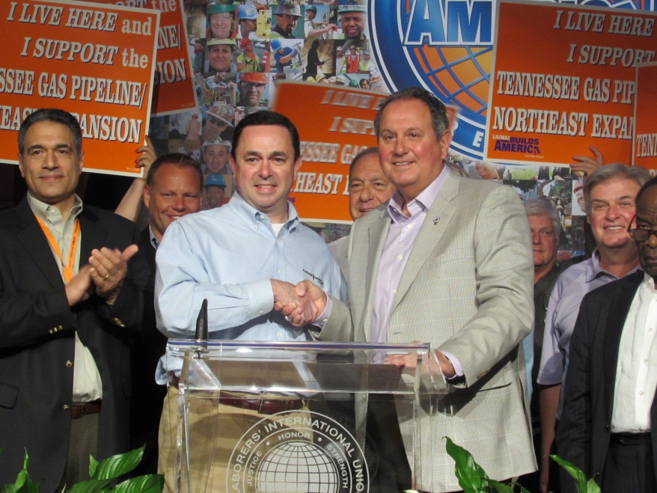



Project Benefits
Tax Income: An estimated additional $1.1M to local taxing bodies in NH
Job Creation: Estimated creation of 3,000 construction-related jobs
Economic Stimulus: Economic benefits to surrounding areas during construction (retail, hospitality, etc.)
Energy Reliability: Providing long-term energy reliability to the region.
Future Economic Growth: Provide capacity for growth; expandable to meet future needs
Kinder Morgan signed a Memorandum of Agreement with the Laborers International Union North America (LiUNA) for the Northeast Energy Direct Project.

Slide 29
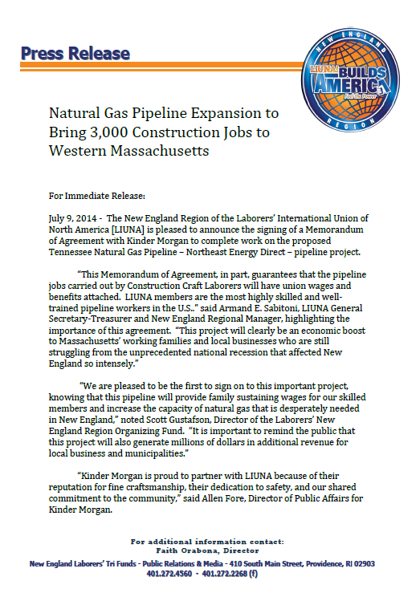
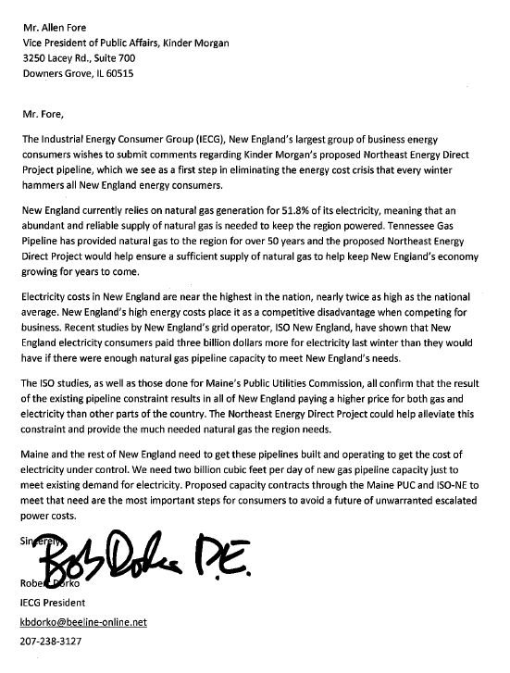
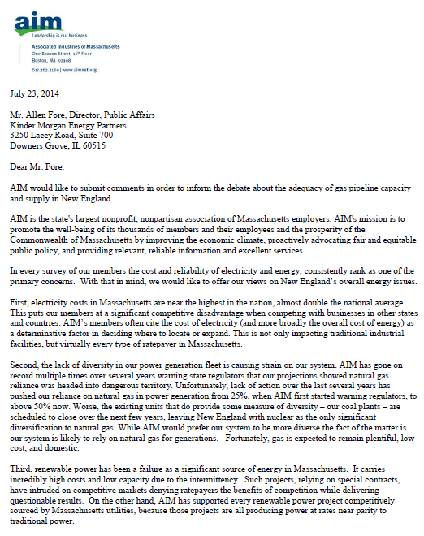
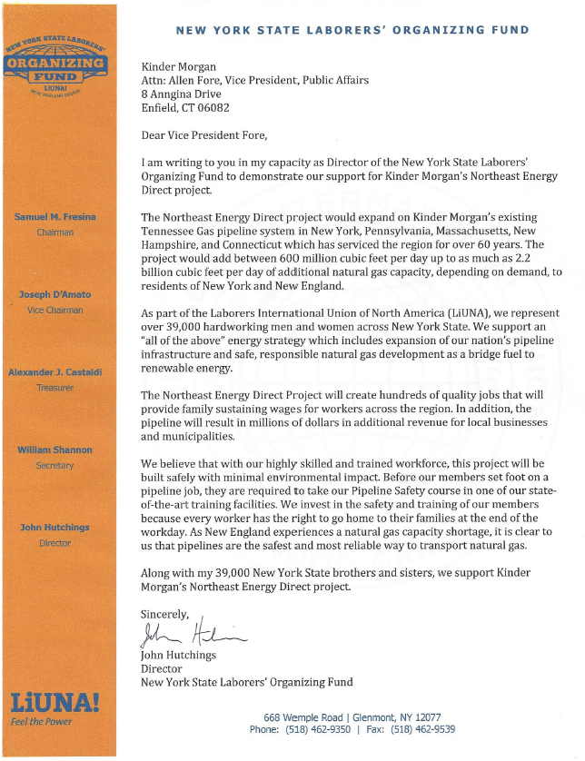
Public Support for Northeast Energy Direct Project
Laborers International Union North America- New England (LiUNA!)
The Industrial Energy Consumer Group (IECG)
Associated Industries of Massachusetts (AIM)
New York State Laborers Organizing Fund

Slide 30
Next Steps
Our Commitment to Local Communities

Slide 31
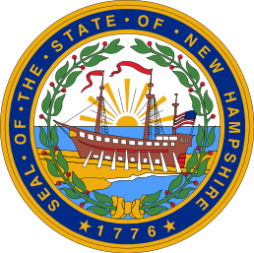
New Hampshire Outreach
Town Contacts:
Hollis, NH
Merrimack, NH
Project Outreach:
Governor Maggie Hassan
Pam Walsh, Governor’s Chief of Staff
Office of US Sen. Kelly Ayotte
Office of US Sen. Jeanne Shaheen
Office of US Rep. Carol Shea Porter
Office of US Rep. Ann Kuster
Meredith Hatfield, Director of the Office of Energy and Planning
Amy Ignatius, Chair of the Public Utilities Commission and Site Evaluation Committee
Tom Burack, Commissioner of Environmental Services
Jeff Rose, Commissioner of Resources and Economic Development
Sen. Chuck Morse, Senate President
Sen. Bob Odell
Sen. Jeb Bradley
Sen. Sharon Carson
Sen. Sylvia Larsen, Senate Minority Leader
Sen. Molly Kelly
Sen. John Rausche
Sen. Jeff Woodburn
Rep. Terie Norelli, Speaker of the House
Rep. Steve Shurtleff, House Majority Leader
Rep. Mary Jane Walner, House Finance Chair
Rep. David Borden, Chair, Science, Tech and Energy Committee
Rep. Charles Townsend
Rep. Jacqueline Cali-Pitts
Rep. Robert Intone
Rep. Beatriz Pastor
Rep. William Baber
Rep. Robert Backus
Rep. Kenneth Grossman
Rep. John Mann
Rep. Ian Raymond
Rep. Marjorie Shepardson
Rep. Amanda Merrill
Rep. Larry Rappaport
Rep. Richard LeVasseur
Rep. Lester Bradley
Rep. Aboul Khan
Rep. Herbert Vadney
Rep. Harold Reilly
Rep. James Devine
Rep. David Murotake
Rep. Mary Griffin
New Hampshire Business and Industry Association.
4

Slide 32
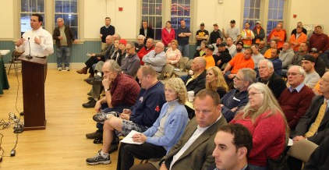
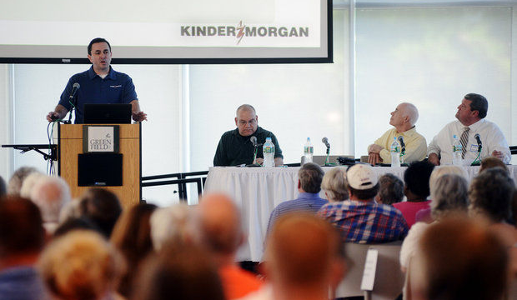
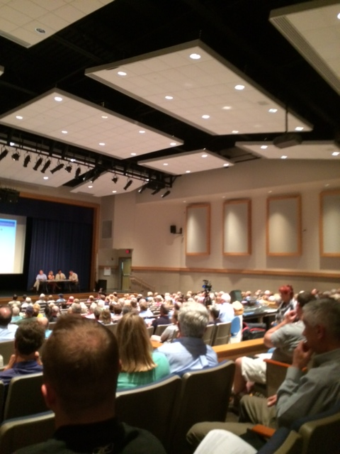
Project Presentations to Date
We have conducted 42 public project presentations to impacted towns, counties and community groups. Over 4,100 people have attended these presentations.
April 7, 2014 : Montague (MA) Board of Selectmen
April 8, 2014: Dracut (MA) Board of Selectmen
April 9, 2014: Ashburnham (MA) Board of Selectmen
April 21, 2014: Hollis (NH) Public Meeting
April 22, 2014: Plainfield (MA) Board of Selectmen
April 23, 2014: Ashby (MA) Board of Selectmen
May 12, 2014: Pepperell (MA) Board of Selectmen
May 13, 2014: Warwick (MA) Public Meeting
May 14, 2014: Tyngsborough (MA) Board of Selectmen
June 4, 2014: Richmond (MA) Board of Selectmen
June 5, 2014: North Reading (MA) Board of Selectmen
June 23, 2014: Groton (MA) Board of Selectmen
June 24, 2014: Tewksbury (MA) Board of Selectmen
June 25, 2014: Townsend (MA) Board of Selectmen
June 26, 2014: Bolton (MA) Board of Selectmen
July 8, 2014: Erving (MA) Board of Selectmen
July 9, 2014: Andover (MA) Board of Selectmen
July 10, 2014: Wilmington (MA) Board of Selectmen
July 15, 2014: Lunenburg (MA) Board of Selectmen
July 22, 2014: Royalston (MA) Board of Selectmen
July 23, 2014: Berlin (MA) Board of Selectmen
July 24, 2014: Shelburne (MA) Board of Selectmen
July 24, 2014: Franklin Regional Council of Governments (MA)
August 5, 2014: Nashoba Valley Chamber of Commerce (MA)
August 12, 2014: Athol (MA) Board of Selectmen
August 14, 2014: Washington (MA) Board of Selectmen.
August 18, 2014: Boylston (MA) Board of Selectmen
August 19, 2014: Northfield (MA) Board of Selectmen
August 20, 2014: Northern Middlesex Council of Governments (MA)
August 26, 2014: Dalton Board of Selectmen (MA)
Sept. 2, 2014: Dunstable Board of Selectmen (MA)
Sept. 16, 2014: Western Mass. EDC
Sept. 17, 2014: Lenox Garden Club (MA)
Sept. 18, 2014: Berkshire Regional Planning Commission (MA)
Sept. 30, 2014: Pittsfield City Council (MA)
Oct. 1, 2014: Northborough (MA)
Oct. 1, 2014: Dracut & Tyngsborough Town Presentation (MA)
Oct. 6, 2014: Winchendon Select Board (MA)
Oct. 8, 2014: Salem, NH Select Board
Oct. 30, 2014: Columbia County, NY
Oct. 30, 2014: Berkshire Chamber of Commerce
Nov. 21, 2014: Sanford, NY Town Board

Slide 33
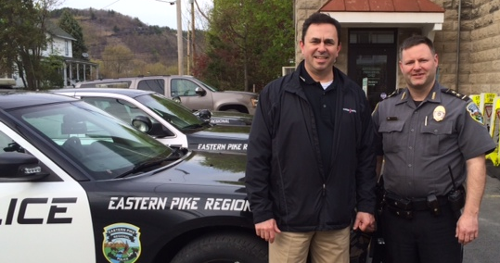
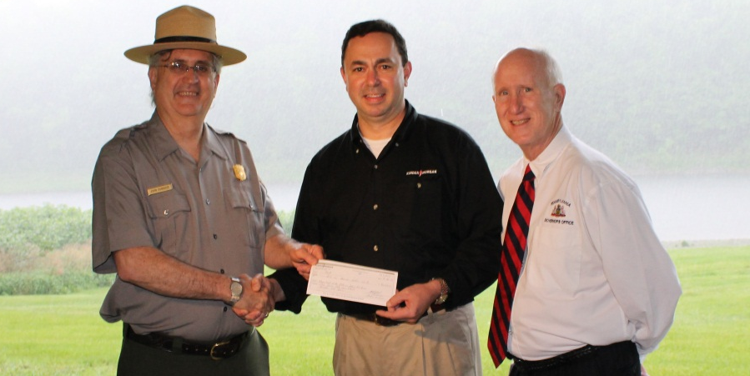
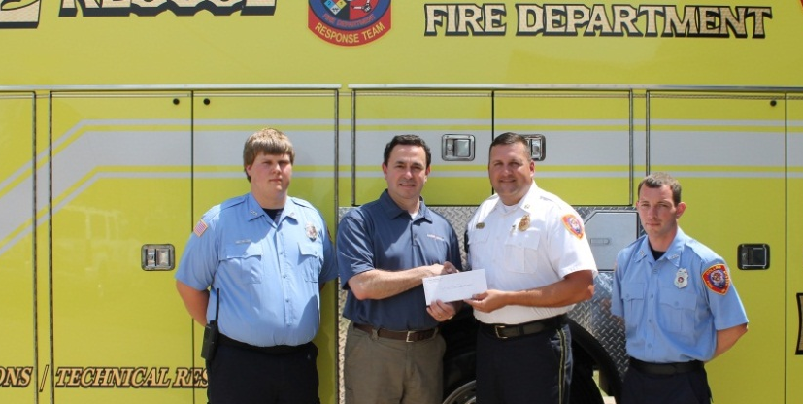
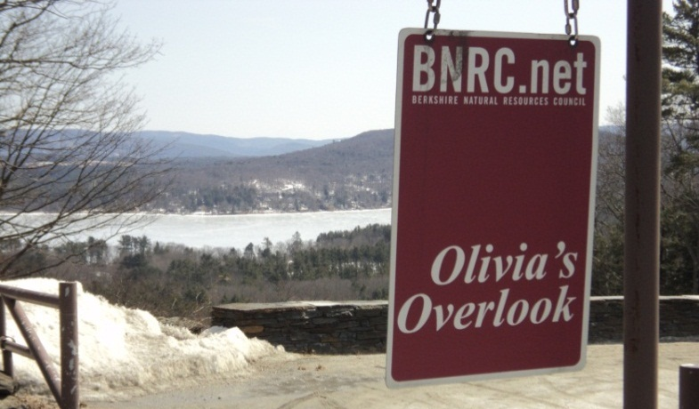
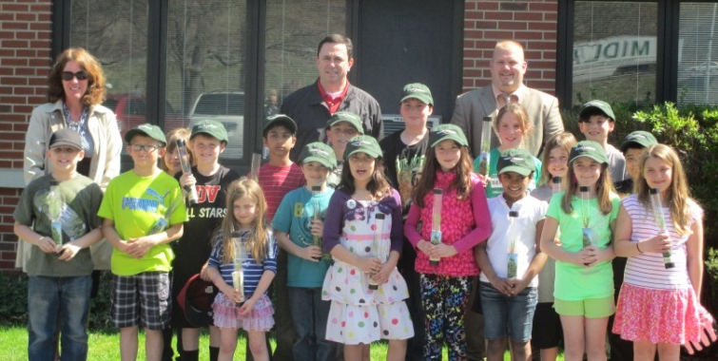

Kinder Morgan in the Community
2014 Donation to Eastern Pike Regional Police Department to support national gas conversion of squad cars.
In 2013, Tennessee Gas Pipeline donated to the Milford Beach in the Delaware Gap National Recreation Area to keep it open for the summer.
In 2013, Parkway Pipeline supported the Collins, MS Fire Department.
In 2013, Kinder Morgan donated 3,000 tree saplings to elementary schools in seven counties across NJ and PA to celebrate Arbor Day.
In cooperation with the Berkshire Natural Resource Council, Tennessee Gas Pipeline provided funding for the Olivia’s Overlook near Lenox, MA.

Slide 34
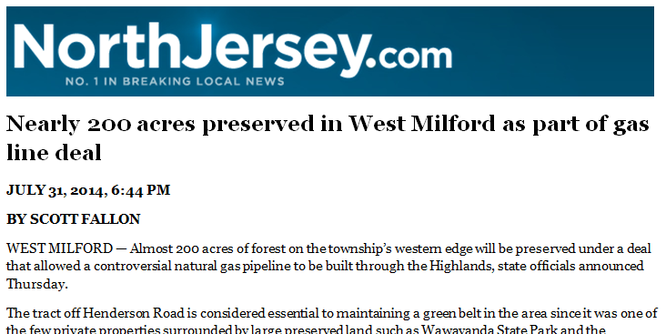
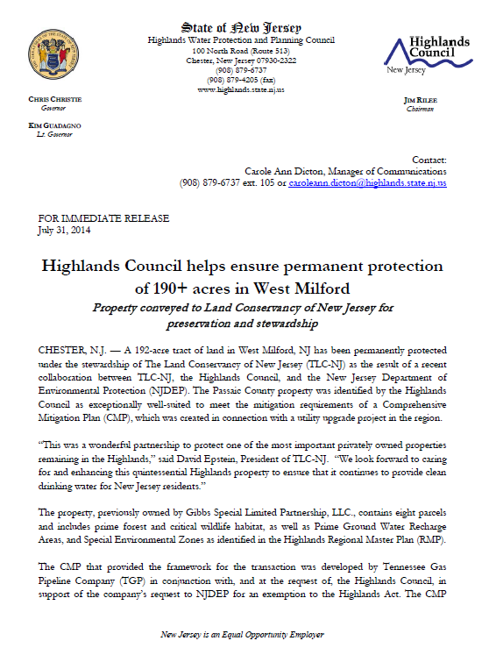
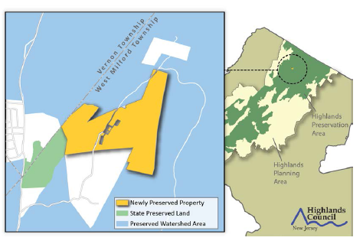
Kinder Morgan in the Community
In July 2013, as part of mitigation agreements on the Northeast Upgrade Project, Tennessee Gas Pipeline funded the purchase of 147 acres of prime forest and critical wildlife habitat lands in West Milford, NJ. The land will be permanently protected under the stewardship of The Land Conservancy of New Jersey in partnership with the Highlands Council.

Slide 35





Kinder Morgan Foundation
The Kinder Morgan Foundation funds programs that promote the academic and artistic interests of young people in the many cities and towns across North America where Kinder Morgan operates.
Science from Scientists, Inc., Boston, MA
Please Touch Museum, Philadelphia, PA
Berkshire Museum, Pittsfield, MA
www.kindermorgan.com/community

Slide 36
Kinder Morgan Contact Information
Project Website:
www.kindermorgan.com/business/gas_pipelines/east/neenergydirect/
Public Affairs/Project Outreach
Allen Fore
630-725-3044
allen_fore@kindermorgan.com
Media Relations
Richard Wheatley
713-420-6828
richard_wheatley@kindermorgan.com
Pittsfield Office:
Crawford Square, 137 North St., Suite 207, Pittsfield, MA 01201
413-464-9544

Slide 37

Kinder Morgan Asset Map

Slide 38
Proposed Northeast Energy Direct Route

